Slide 1
Welcome to SDQSG’s Zoom Meeting!

Slide 2
If you are feeling like… OR
…DON’T WORRY! We’re here to help!

Slide 3
The slides you are about to see will work with MOST devices you may be using, but if yours doesn’t look EXACTLY the same, or some features are missing, it’s okay. Not all devices are created equal. We’ll help you figure it out. ☺

Slide 5
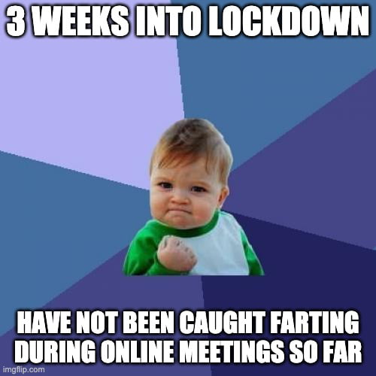
Please keep your microphone muted unless you are presenting

Slide 6
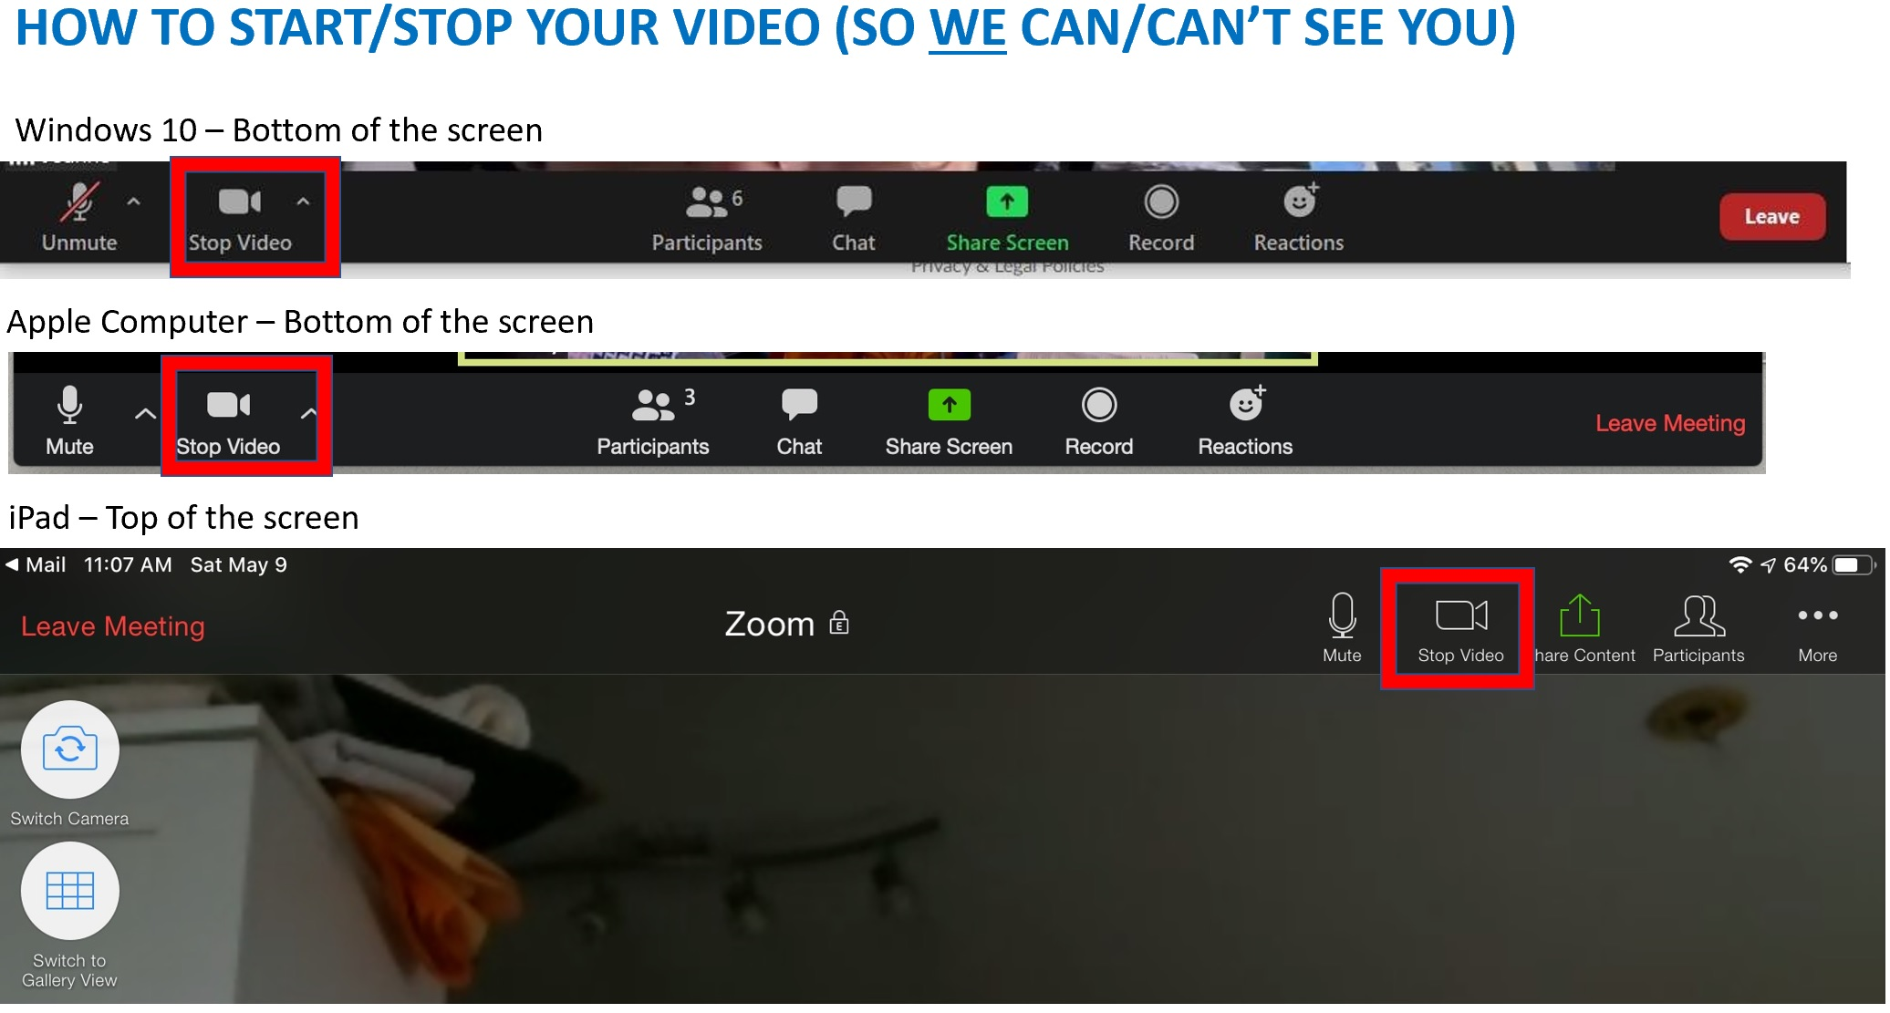

Slide 7
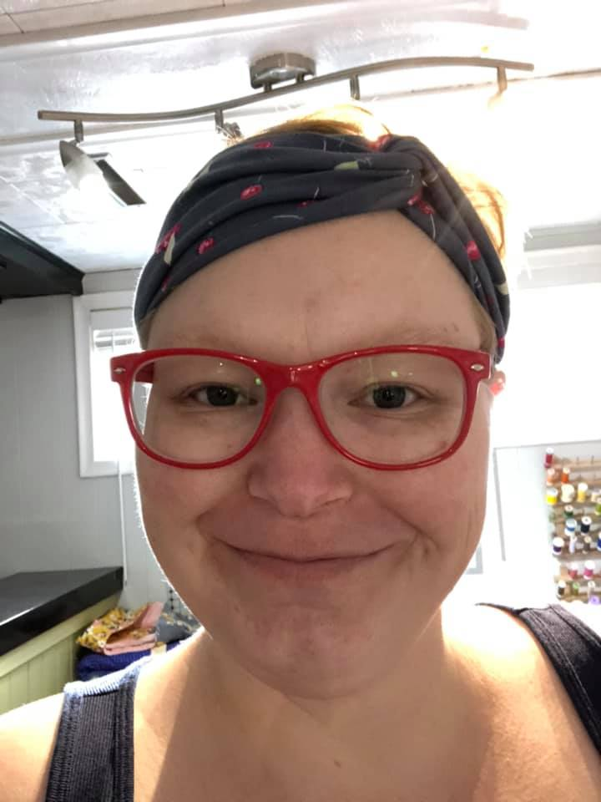
It’s your choice whether or not you want us to see your beautiful face
(Hello, from your tech team!)

Slide 8
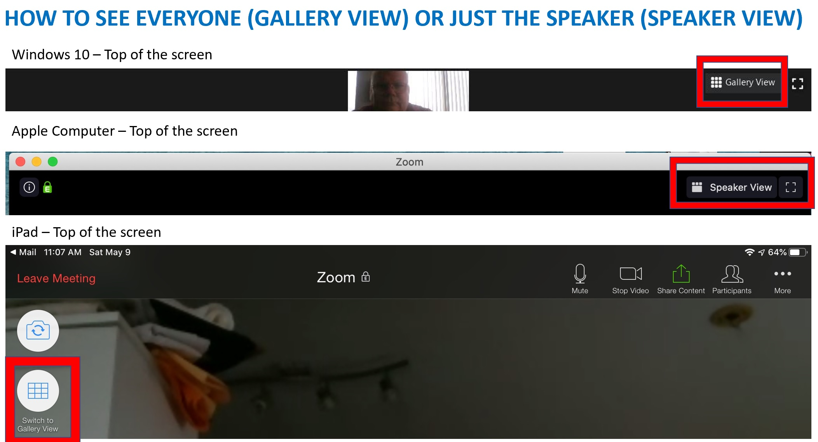

Slide 9
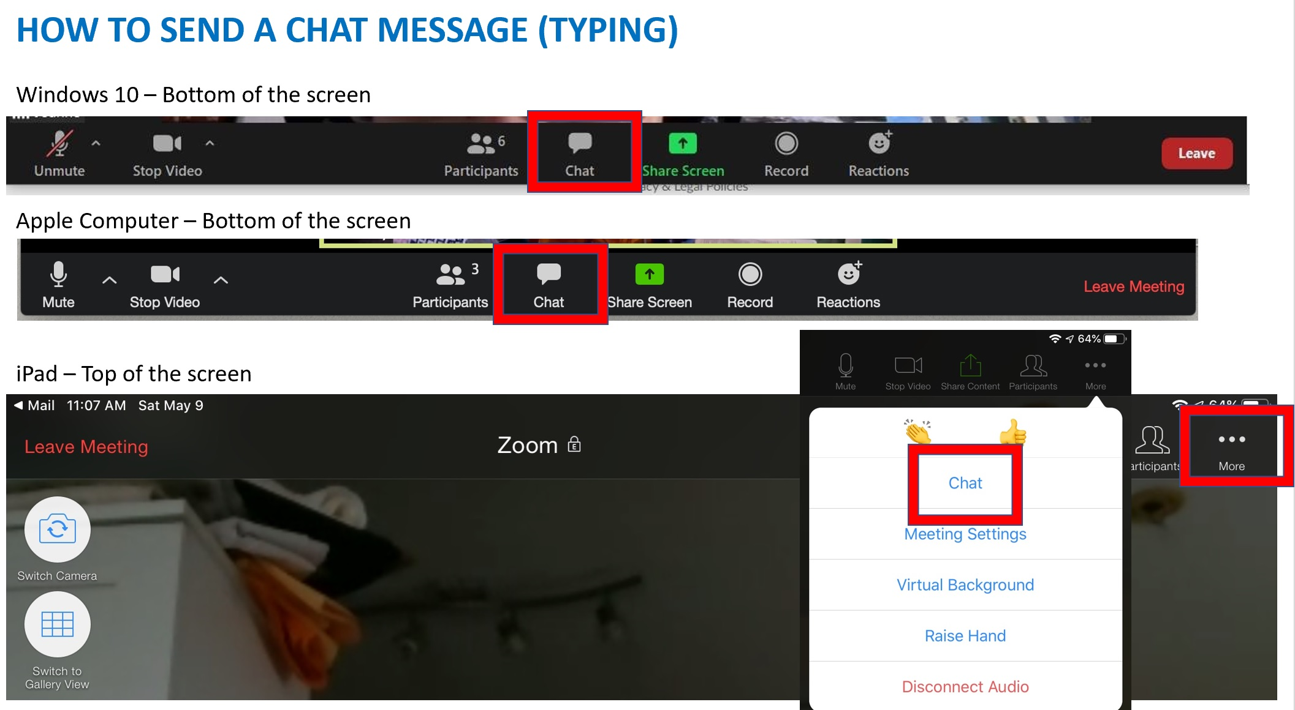

Slide 10
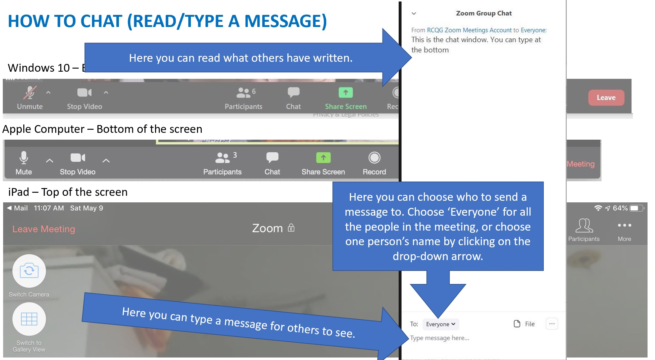

Slide 11
FYI: We will have someone reading the chat messages, so this is a good place to type a question if you have one for a speaker.

Slide 12
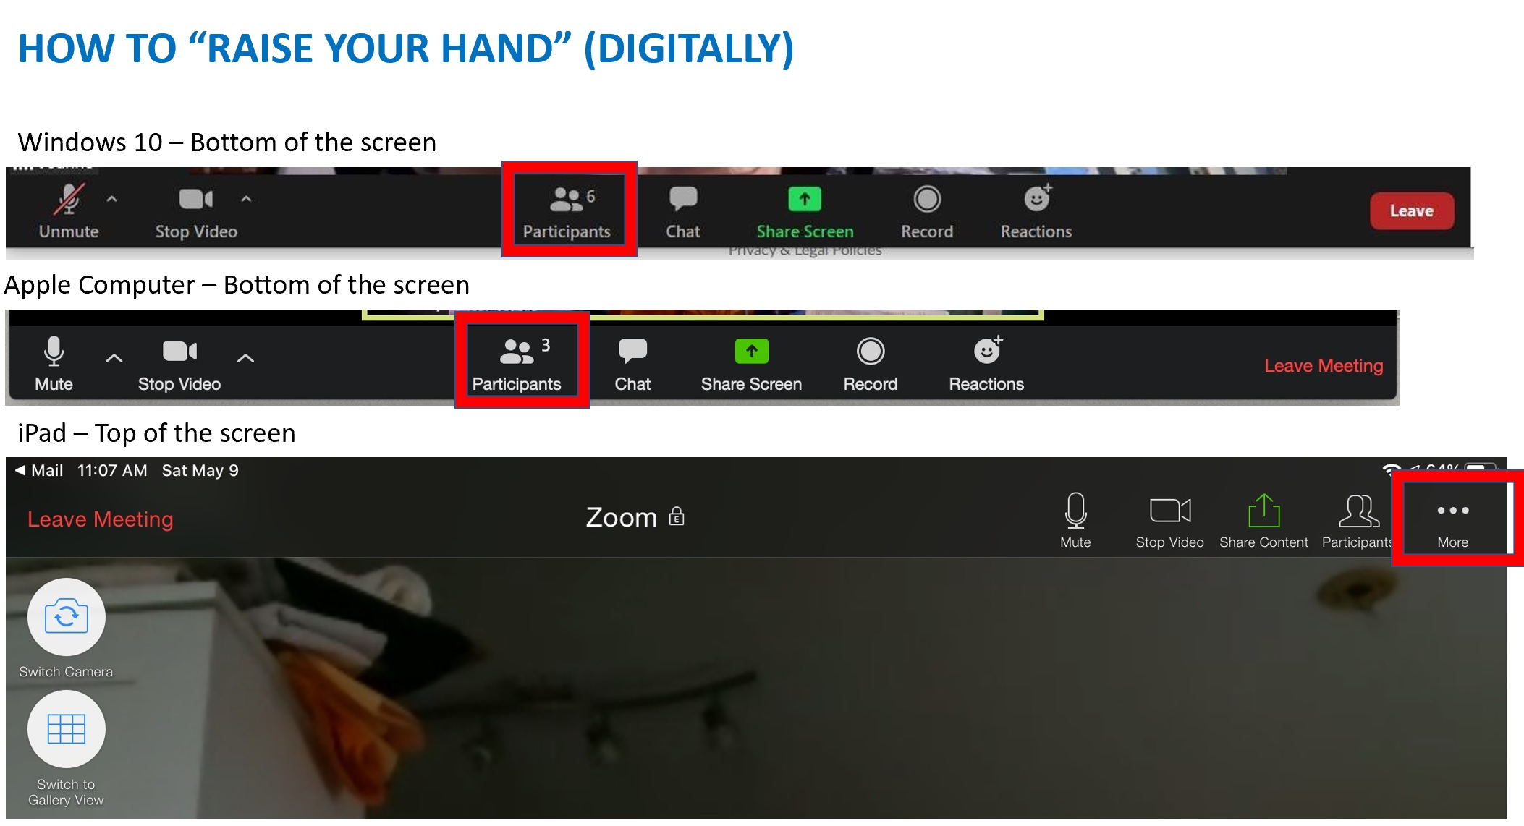

Slide 13
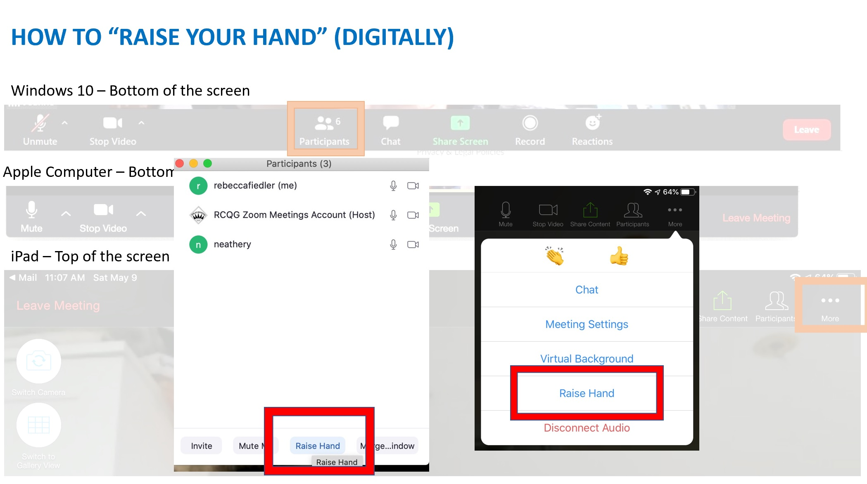

Slide 14
FYI: This is another good way of letting us know you have a question and/or comment

Slide 15
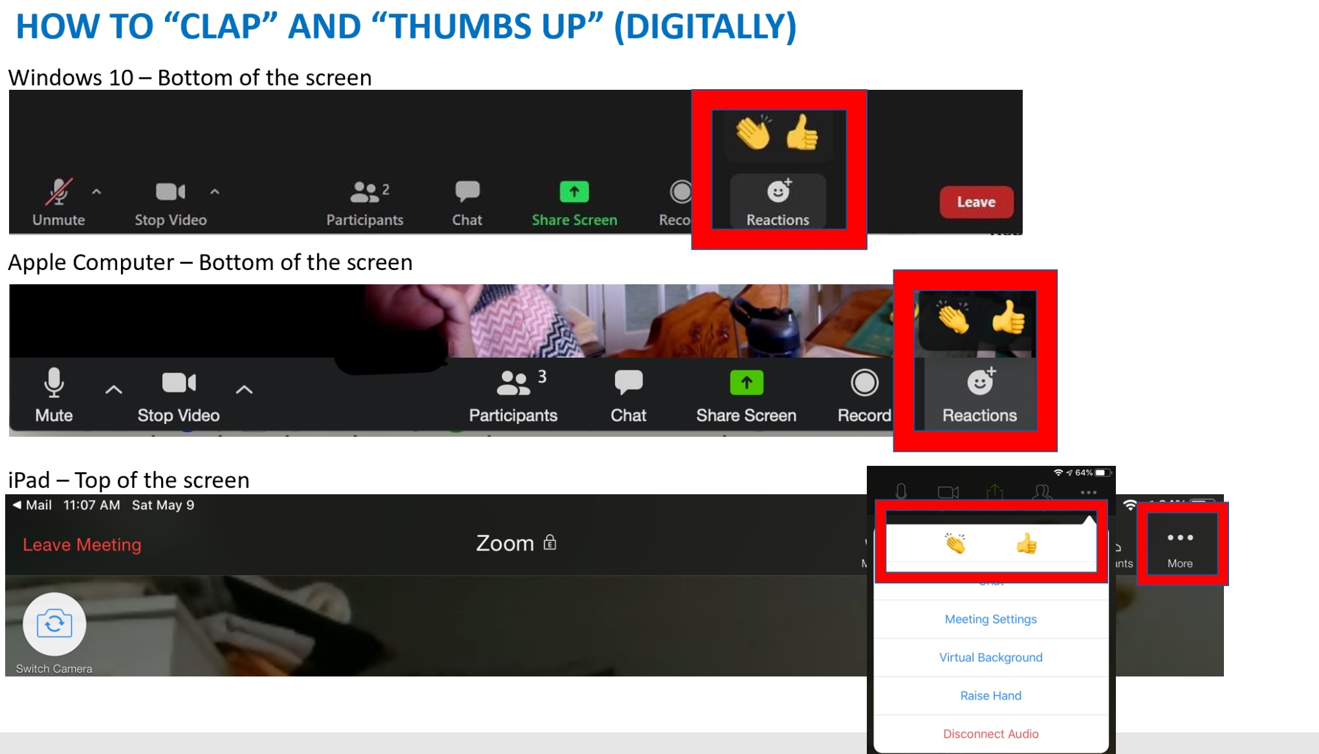

Slide 16
